Slide 1
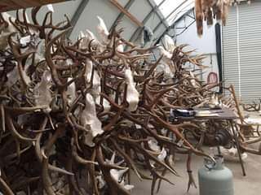
Skull Cleaning
Effective 10/1/25
Min 3 Month
Turn around
time
Full Payment required at time of Drop Off
Deer | $ 135.00
Antelope | $ 135.00
Bear/Lion | $ 135.00
Grizzly | $ 165.00
Elk | $ 180.00
Moose | $ 200.00
Buffalo | $ 255.00

